Slide 1
Project: Customer Segmentation
萬能科技大學資訊工程系暨電資研究所
江義淵 助理教授

Slide 2
Project範本及資料在哪裡？
https://github.com/udacity/machine-learning

Slide 3
Overview

Slide 4
Project Overview (1/5)
In this project you will apply unsupervised learning techniques on product spending data (產品開銷資料) collected for customers of a wholesale distributor in Lisbon, Portugal to identify customer segments hidden in the data.

Slide 5
Project Overview (2/5)
You will first explore the data by selecting a small subset to sample and determine if any product categories highly correlate with one another.

Slide 6
Project Overview (3/5)
Afterwards, you will preprocess the data by scaling each product category and then identifying (and removing) unwanted outliers.

Slide 7
Project Overview (4/5)
With the good, clean customer spending data, you will apply PCA transformations to the data and implement clustering algorithms to segment the transformed customer data.

Slide 8
Project Overview (5/5)
Finally, you will compare the segmentation found with an additional labeling and consider ways this information could assist the wholesale distributor with future service changes.

Slide 9
Things you will learn by completing this project:
How to apply preprocessing techniques such as feature scaling and outlier detection.
How to interpret data points that have been scaled, transformed, or reduced from PCA.
How to analyze PCA dimensions and construct a new feature space.
How to optimally cluster a set of data to find hidden patterns in a dataset.
How to assess information given by cluster data and use it in a meaningful way.

Slide 10
Things you will learn by completing this project:
How to apply preprocessing techniques such as feature scaling and outlier detection.
How to interpret data points that have been scaled, transformed, or reduced from PCA.
How to analyze PCA dimensions and construct a new feature space.
How to optimally cluster a set of data to find hidden patterns in a dataset.
How to assess information given by cluster data and use it in a meaningful way.

Slide 11
Things you will learn by completing this project:
How to apply preprocessing techniques such as feature scaling and outlier detection.
How to interpret data points that have been scaled, transformed, or reduced from PCA.
How to analyze PCA dimensions and construct a new feature space.
How to optimally cluster a set of data to find hidden patterns in a dataset.
How to assess information given by cluster data and use it in a meaningful way.

Slide 12
Things you will learn by completing this project:
How to apply preprocessing techniques such as feature scaling and outlier detection.
How to interpret data points that have been scaled, transformed, or reduced from PCA.
How to analyze PCA dimensions and construct a new feature space.
How to optimally cluster a set of data to find hidden patterns in a dataset.
How to assess information given by cluster data and use it in a meaningful way.

Slide 13
Things you will learn by completing this project:
How to apply preprocessing techniques such as feature scaling and outlier detection.
How to interpret data points that have been scaled, transformed, or reduced from PCA.
How to analyze PCA dimensions and construct a new feature space.
How to optimally cluster a set of data to find hidden patterns in a dataset.
How to assess information given by cluster data and use it in a meaningful way.

Slide 14
Description & Software Requirements

Slide 15
Description
A wholesale distributor recently tested a change to their delivery method for some customers, by moving from a morning delivery service five days a week to a cheaper evening delivery service three days a week. Initial testing did not discover any significant unsatisfactory results, so they implemented the cheaper option for all customers. Almost immediately, the distributor began getting complaints about the delivery service change and customers were canceling deliveries — losing the distributor more money than what was being saved. You’ve been hired by the wholesale distributor to find what types of customers they have to help them make better, more informed business decisions in the future. Your task is to use unsupervised learning techniques to see if any similarities exist between customers, and how to best segment customers into distinct categories.

Slide 16
Description
A wholesale distributor recently tested a change to their delivery method for some customers, by moving from a morning delivery service five days a week to a cheaper evening delivery service three days a week. Initial testing did not discover any significant unsatisfactory results, so they implemented the cheaper option for all customers. Almost immediately, the distributor began getting complaints about the delivery service change and customers were canceling deliveries — losing the distributor more money than what was being saved. You’ve been hired by the wholesale distributor to find what types of customers they have to help them make better, more informed business decisions in the future. Your task is to use unsupervised learning techniques to see if any similarities exist between customers, and how to best segment customers into distinct categories.

Slide 17
Description
A wholesale distributor recently tested a change to their delivery method for some customers, by moving from a morning delivery service five days a week to a cheaper evening delivery service three days a week. Initial testing did not discover any significant unsatisfactory results, so they implemented the cheaper option for all customers. Almost immediately, the distributor began getting complaints about the delivery service change and customers were canceling deliveries — losing the distributor more money than what was being saved. You’ve been hired by the wholesale distributor to find what types of customers they have to help them make better, more informed business decisions in the future. Your task is to use unsupervised learning techniques to see if any similarities exist between customers, and how to best segment customers into distinct categories.

Slide 18
Description
A wholesale distributor recently tested a change to their delivery method for some customers, by moving from a morning delivery service five days a week to a cheaper evening delivery service three days a week. Initial testing did not discover any significant unsatisfactory results, so they implemented the cheaper option for all customers. Almost immediately, the distributor began getting complaints about the delivery service change and customers were canceling deliveries — losing the distributor more money than what was being saved. You’ve been hired by the wholesale distributor to find what types of customers they have to help them make better, more informed business decisions in the future. Your task is to use unsupervised learning techniques to see if any similarities exist between customers, and how to best segment customers into distinct categories.

Slide 19
Description
A wholesale distributor recently tested a change to their delivery method for some customers, by moving from a morning delivery service five days a week to a cheaper evening delivery service three days a week. Initial testing did not discover any significant unsatisfactory results, so they implemented the cheaper option for all customers. Almost immediately, the distributor began getting complaints about the delivery service change and customers were canceling deliveries — losing the distributor more money than what was being saved. You’ve been hired by the wholesale distributor to find what types of customers they have to help them make better, more informed business decisions in the future. Your task is to use unsupervised learning techniques to see if any similarities exist between customers, and how to best segment customers into distinct categories.

Slide 20
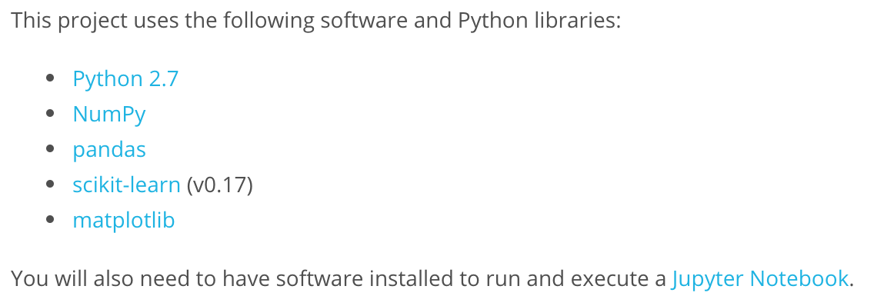
Software and Libraries

Slide 21
Starting the project

Slide 22
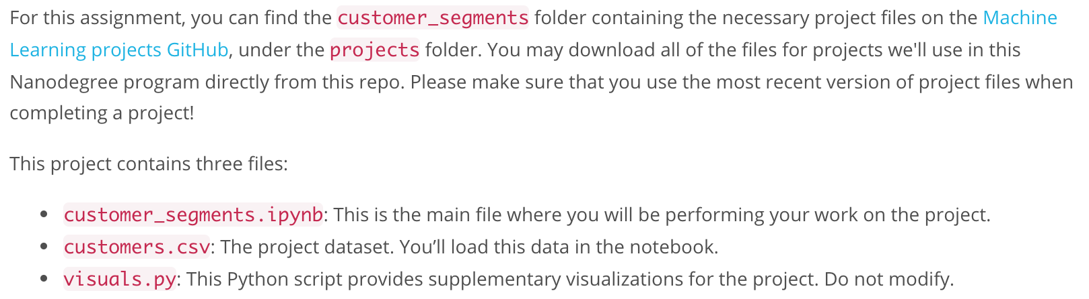
Go to GitHub…

Slide 23
Project Specification

Slide 24
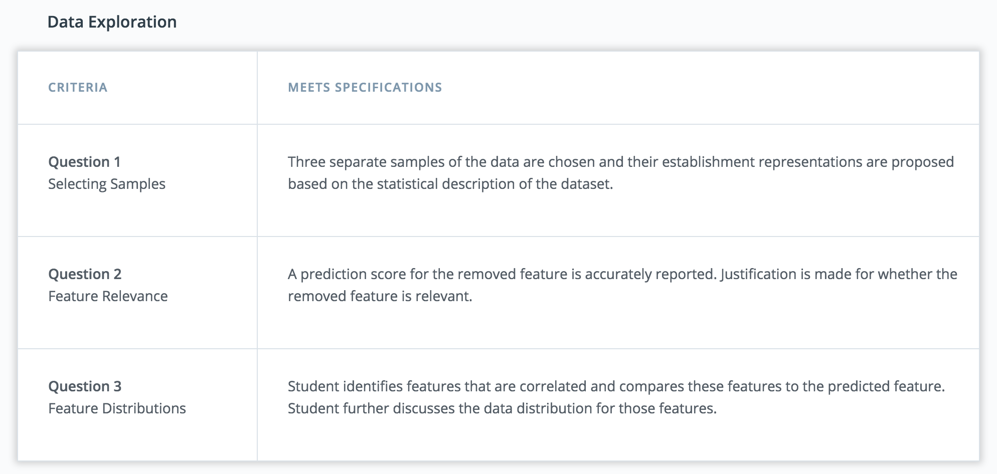

Slide 25
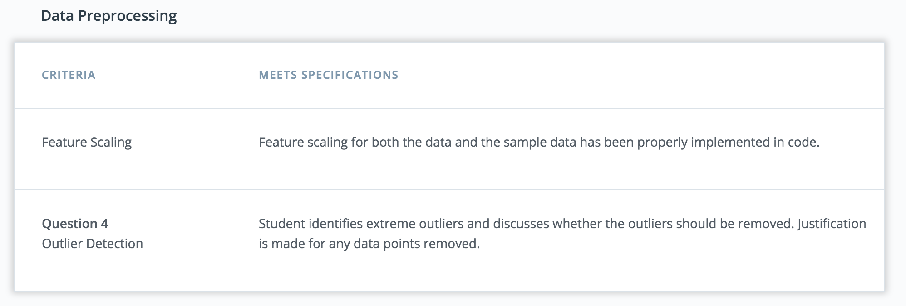

Slide 26
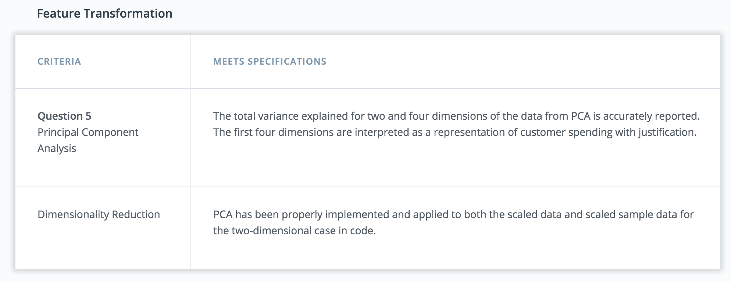

Slide 27
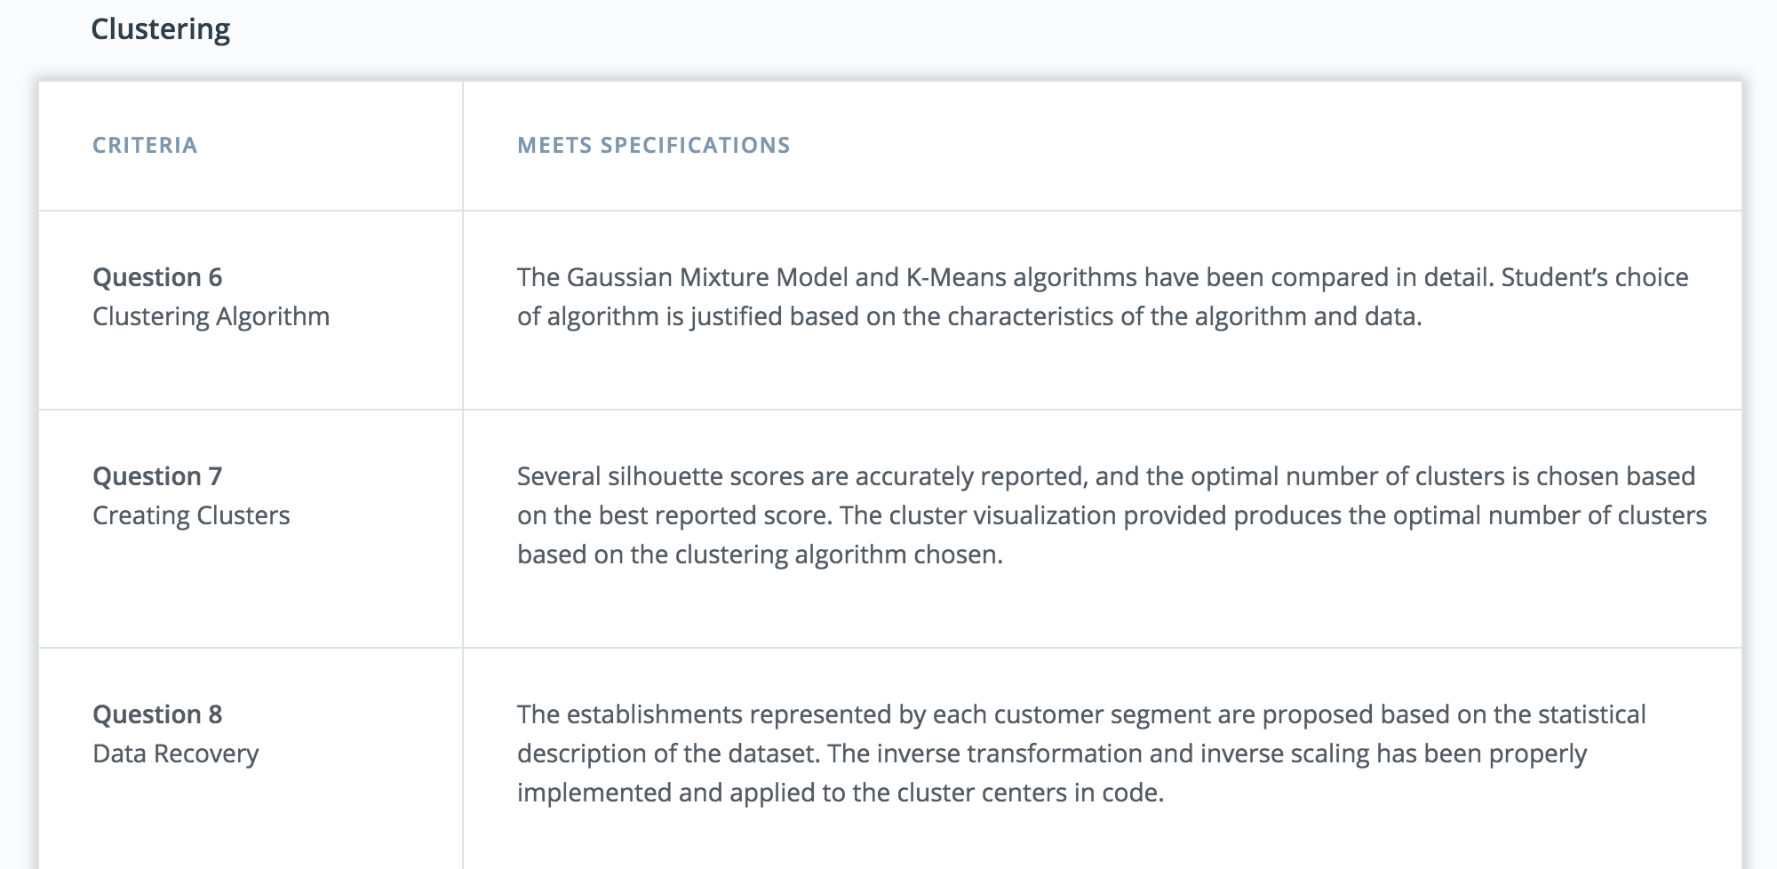

Slide 28
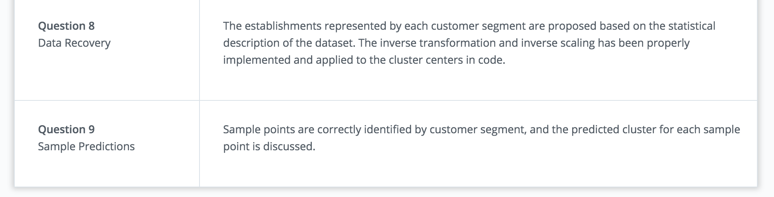

Slide 29
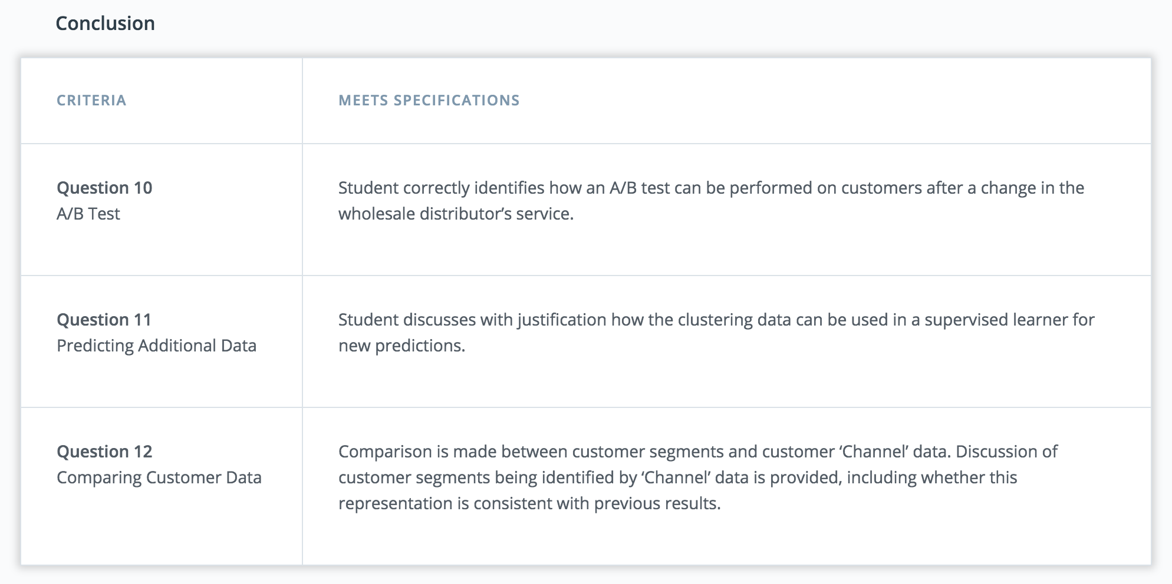

Slide 30
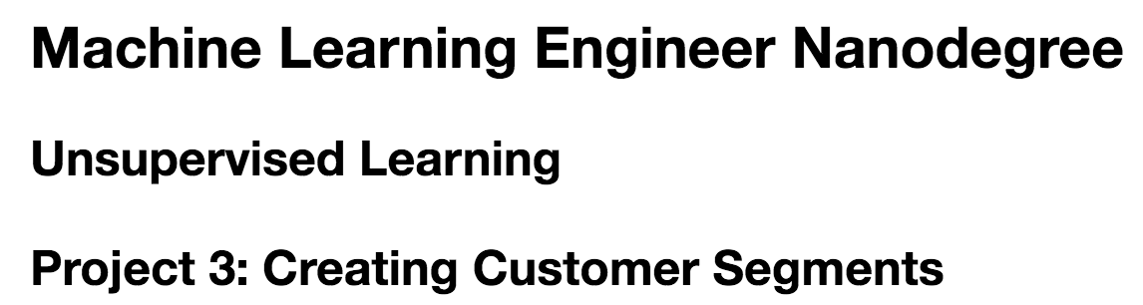

Slide 31
Getting Started

Slide 32
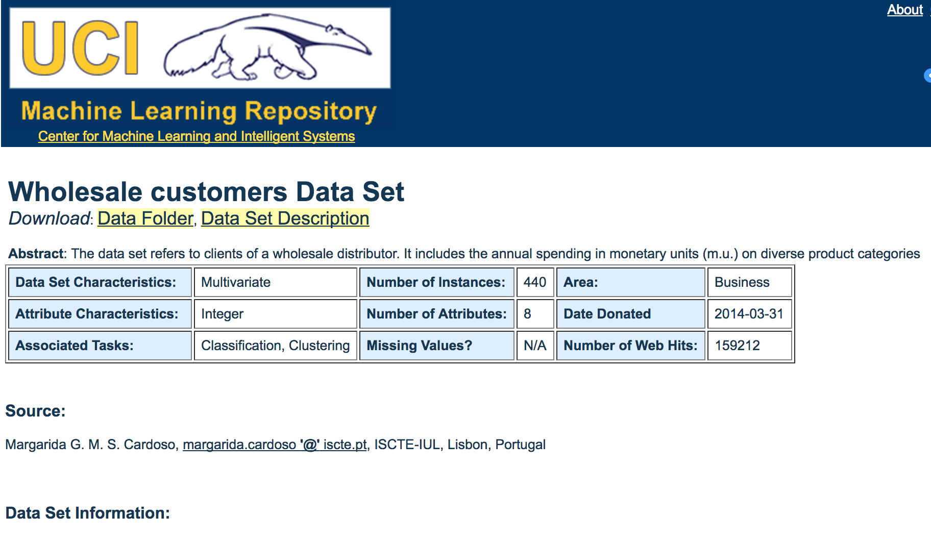
Getting Started
The dataset can be found in:

Slide 33
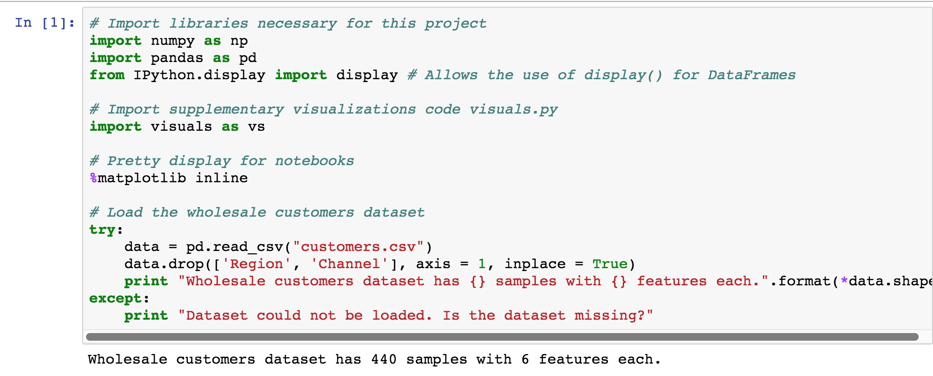

Slide 34
Data Exploration

Slide 35
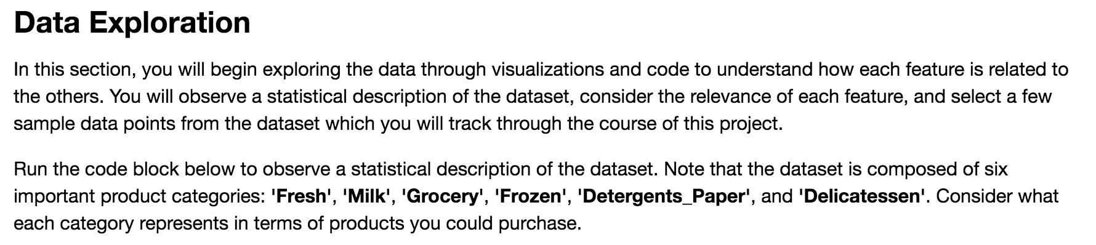

Slide 36
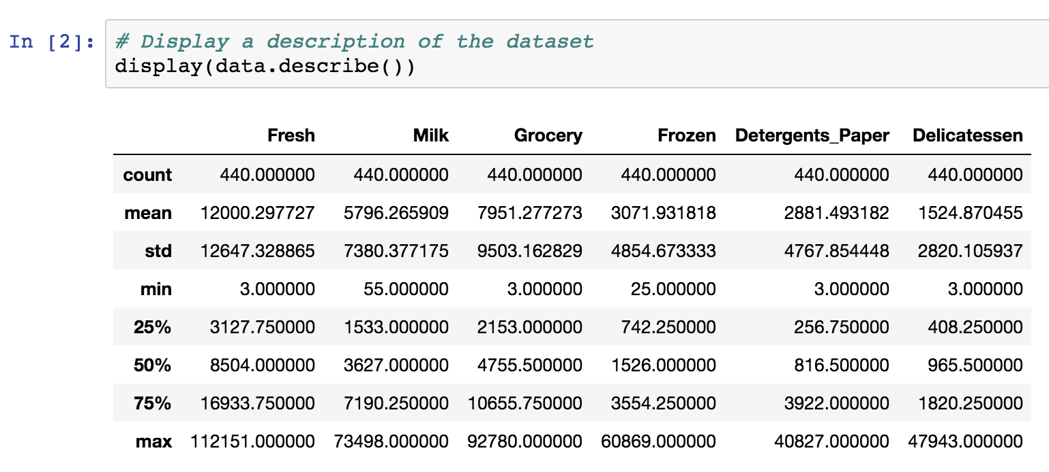

Slide 37
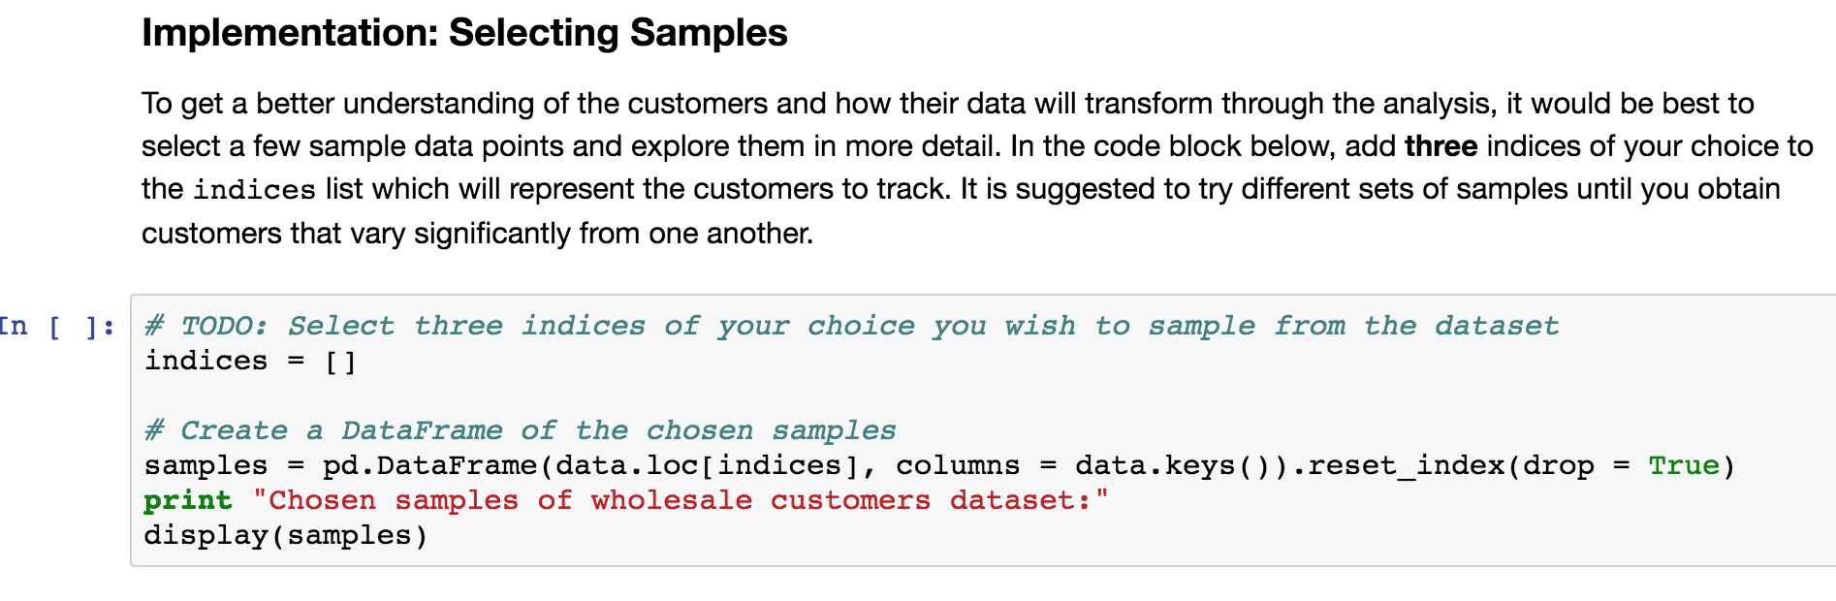

Slide 38
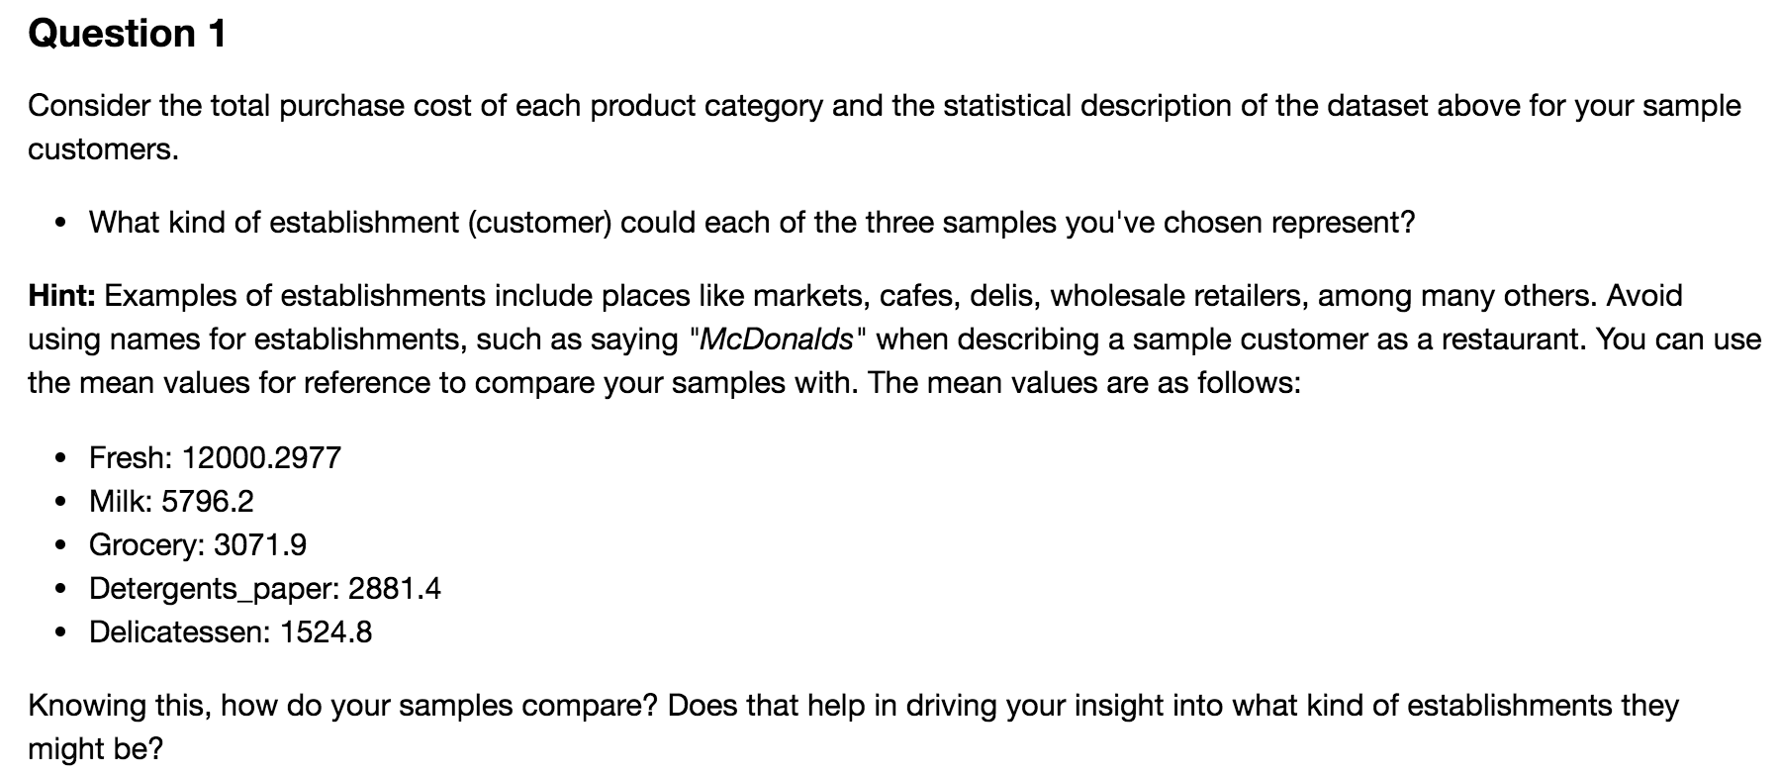

Slide 39
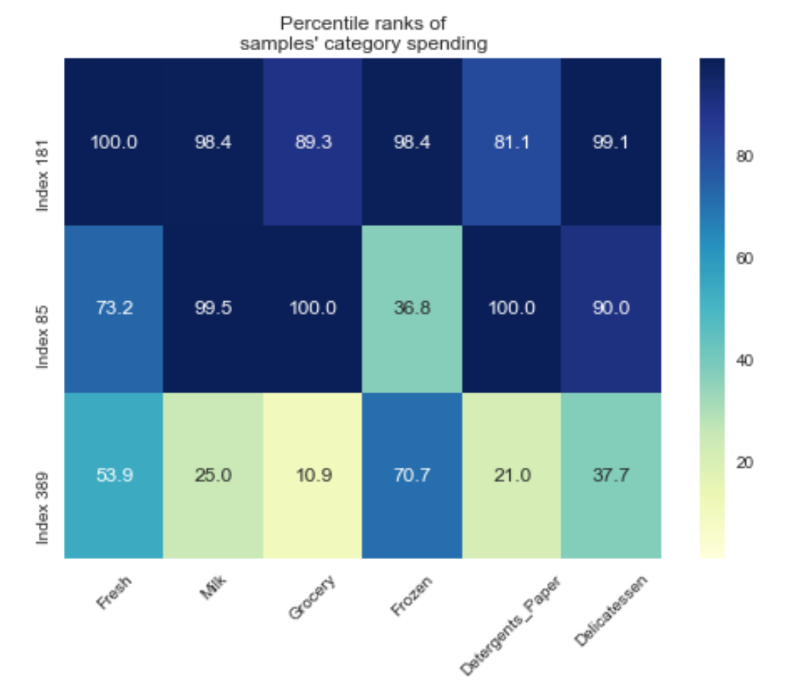

Slide 40
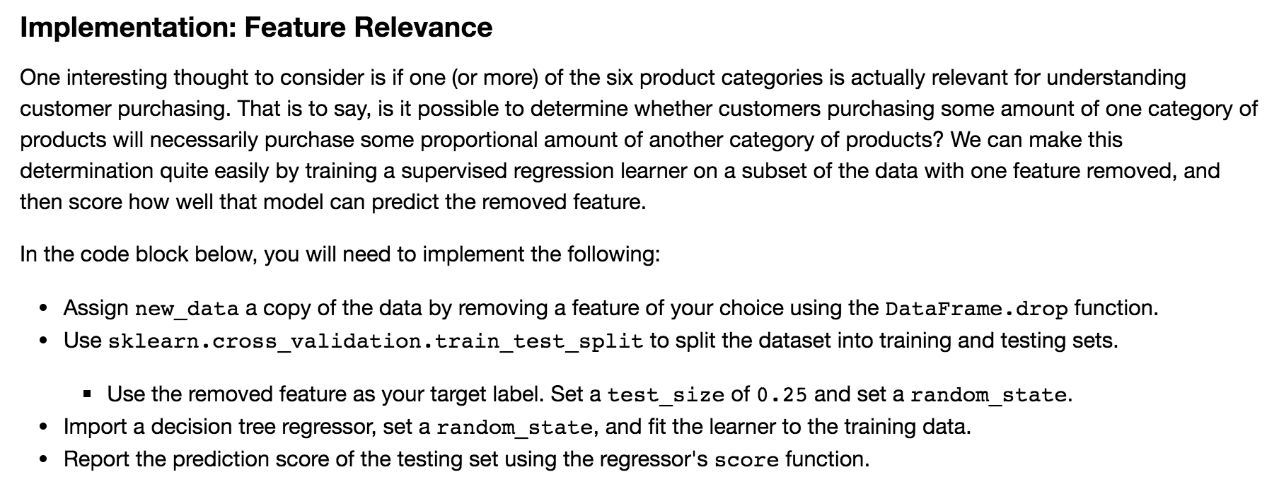

Slide 41
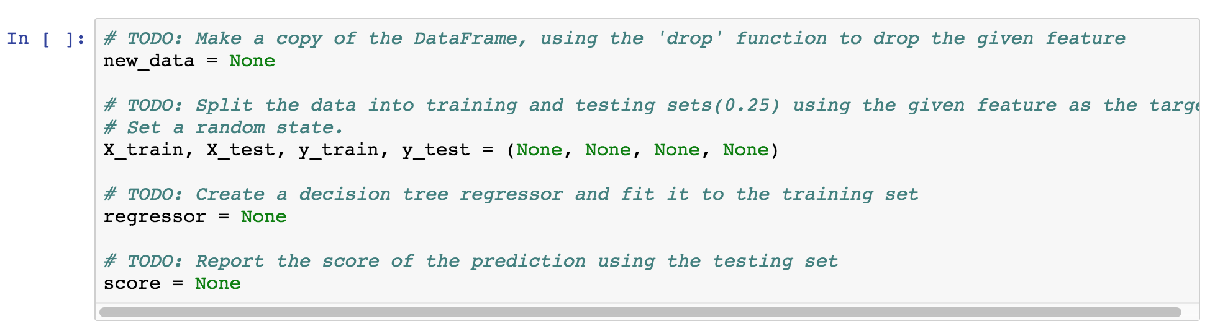
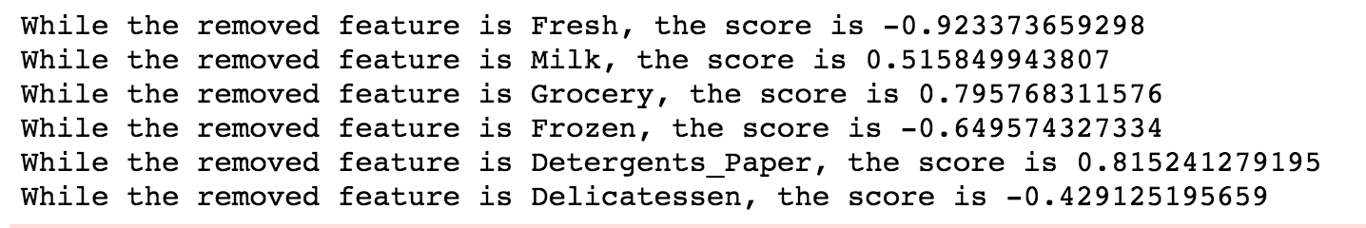

Slide 42
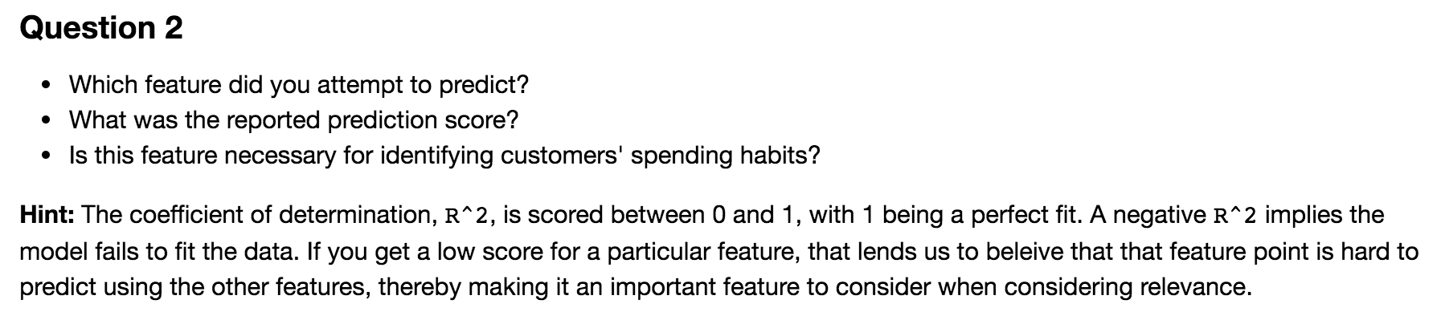

Slide 43
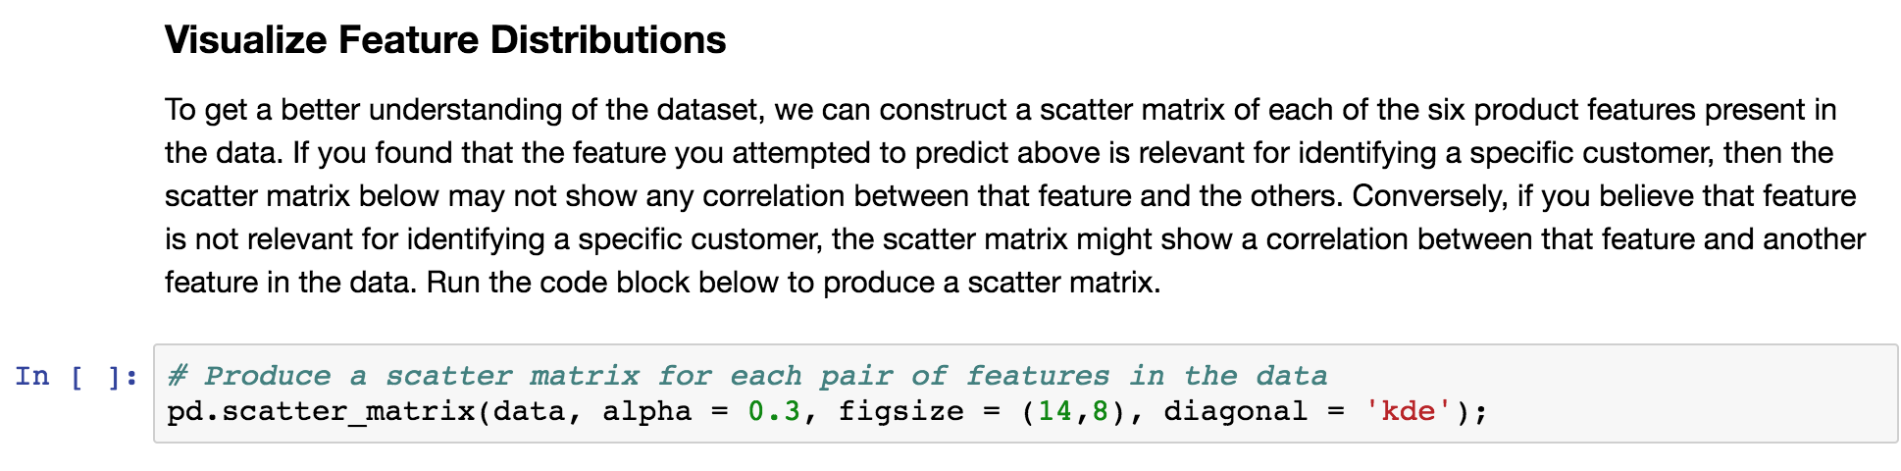

Slide 44
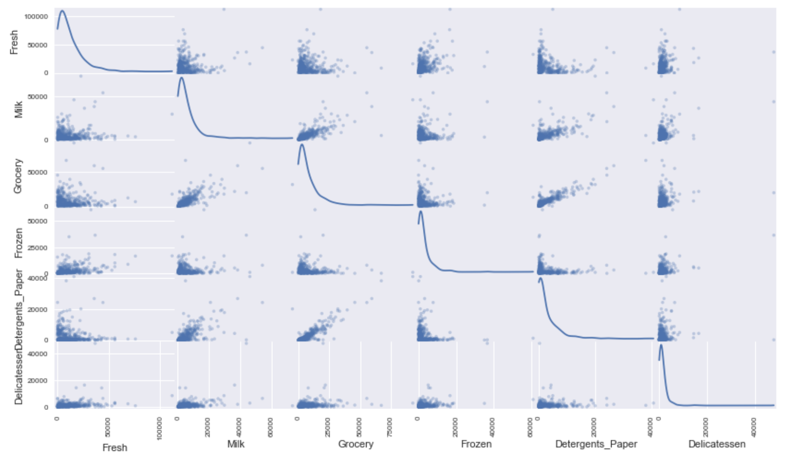

Slide 45
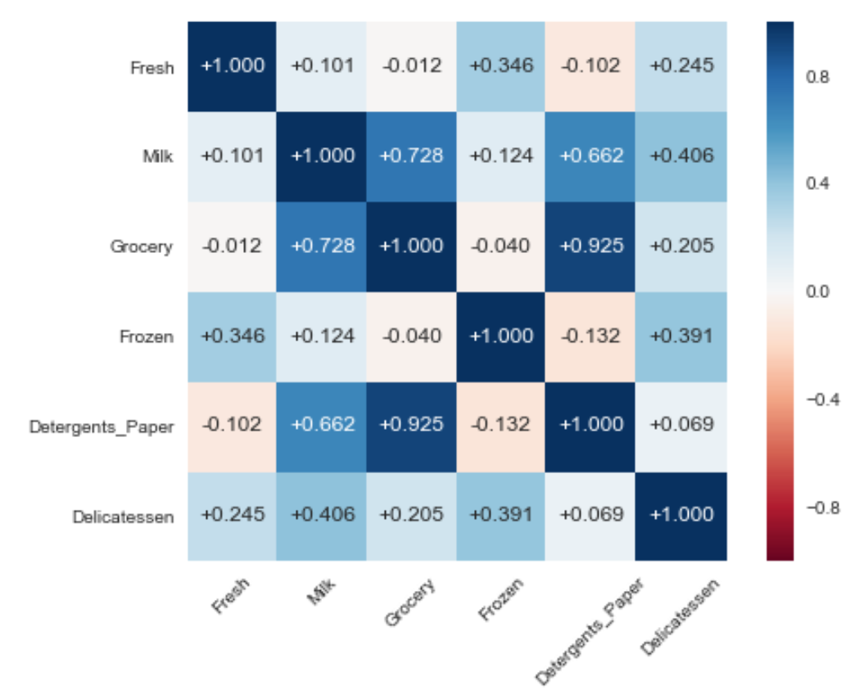

Slide 46
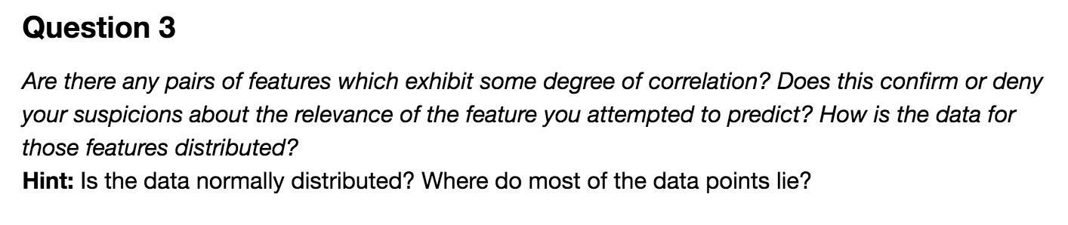

Slide 47
Data Preprocessing

Slide 48
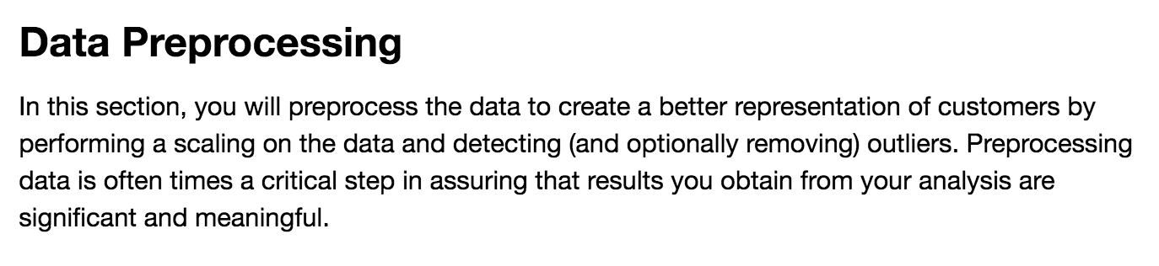

Slide 49
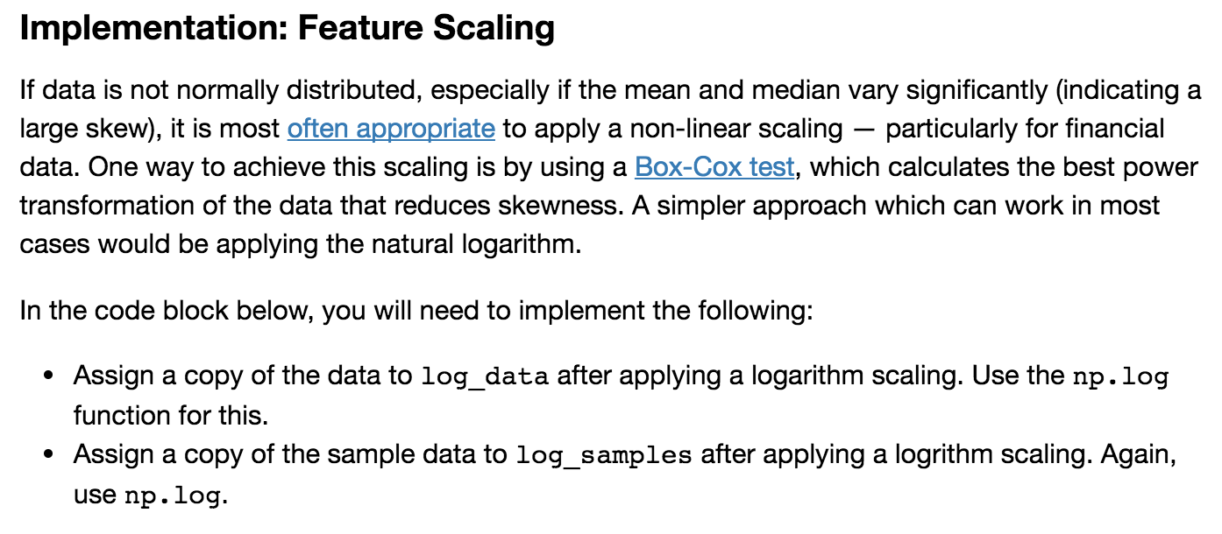

Slide 50
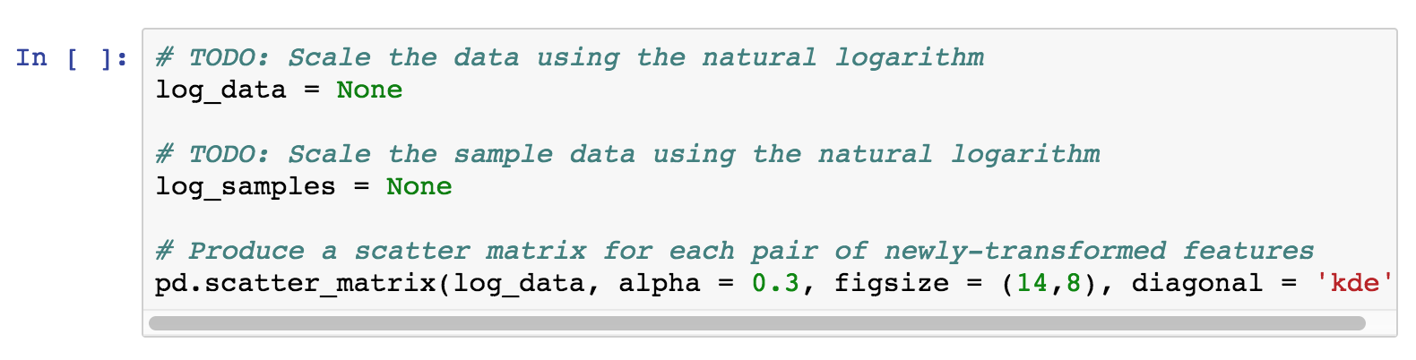

Slide 51
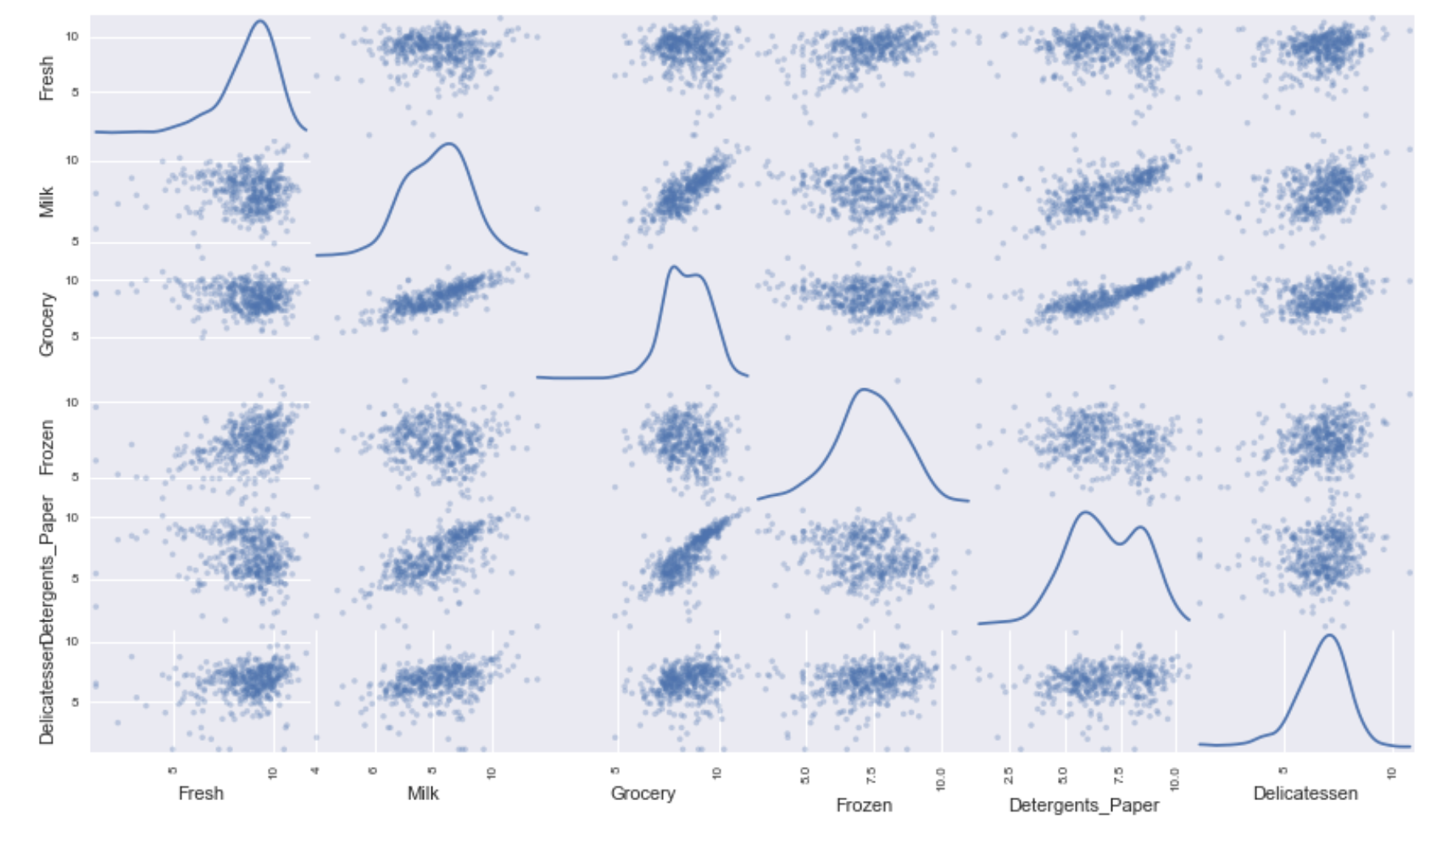

Slide 52
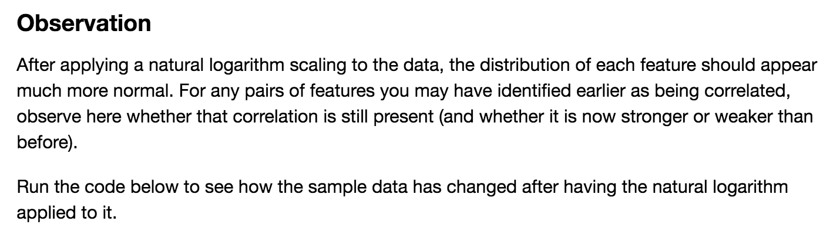

Slide 53
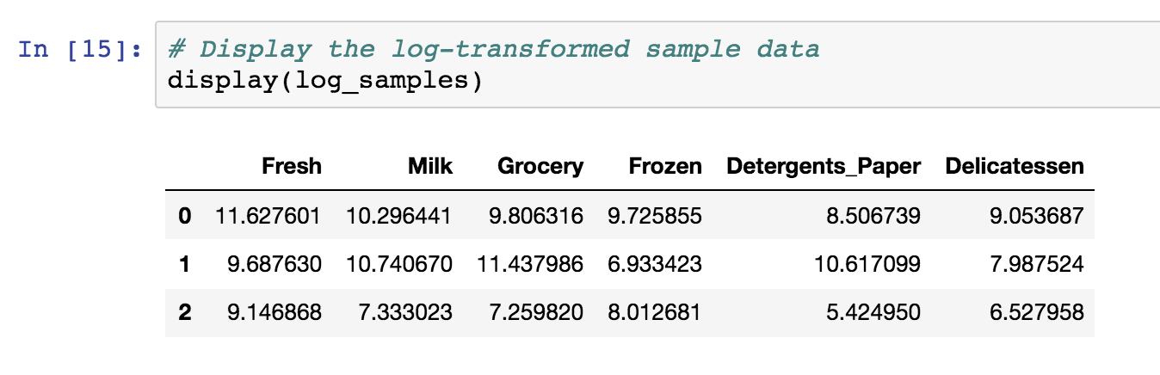

Slide 54
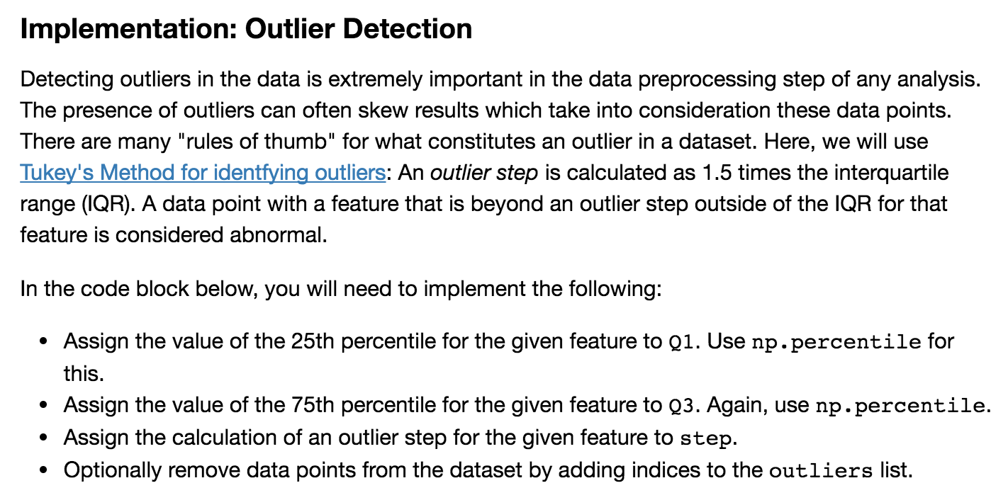

Slide 55
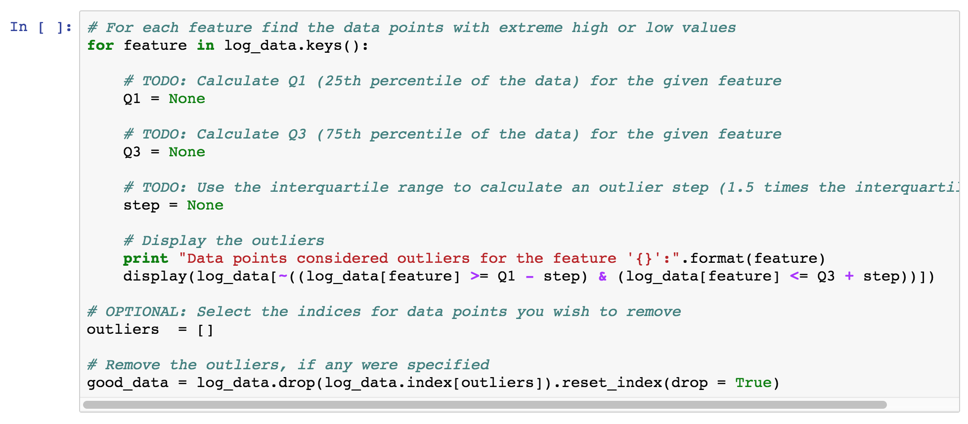

Slide 56
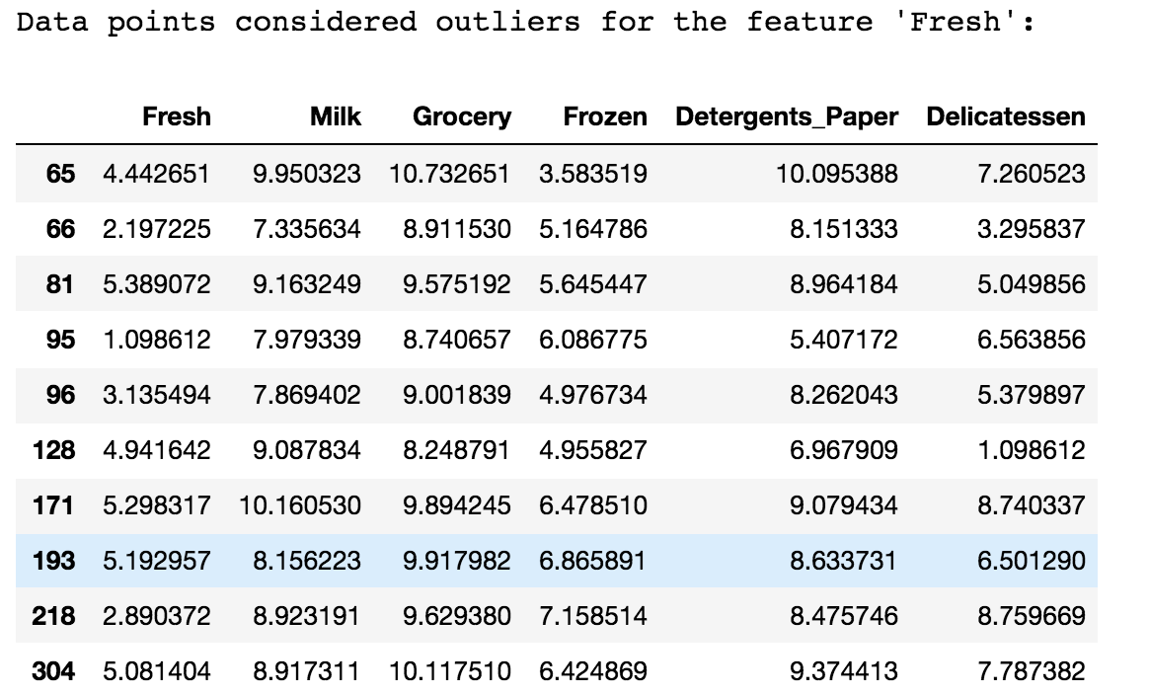

Slide 57
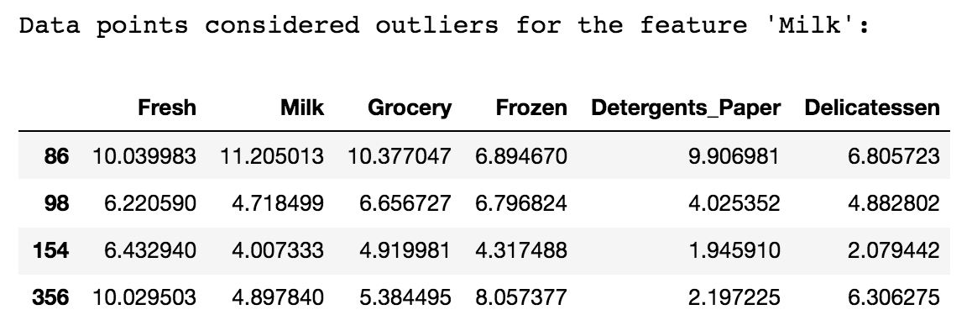

Slide 58
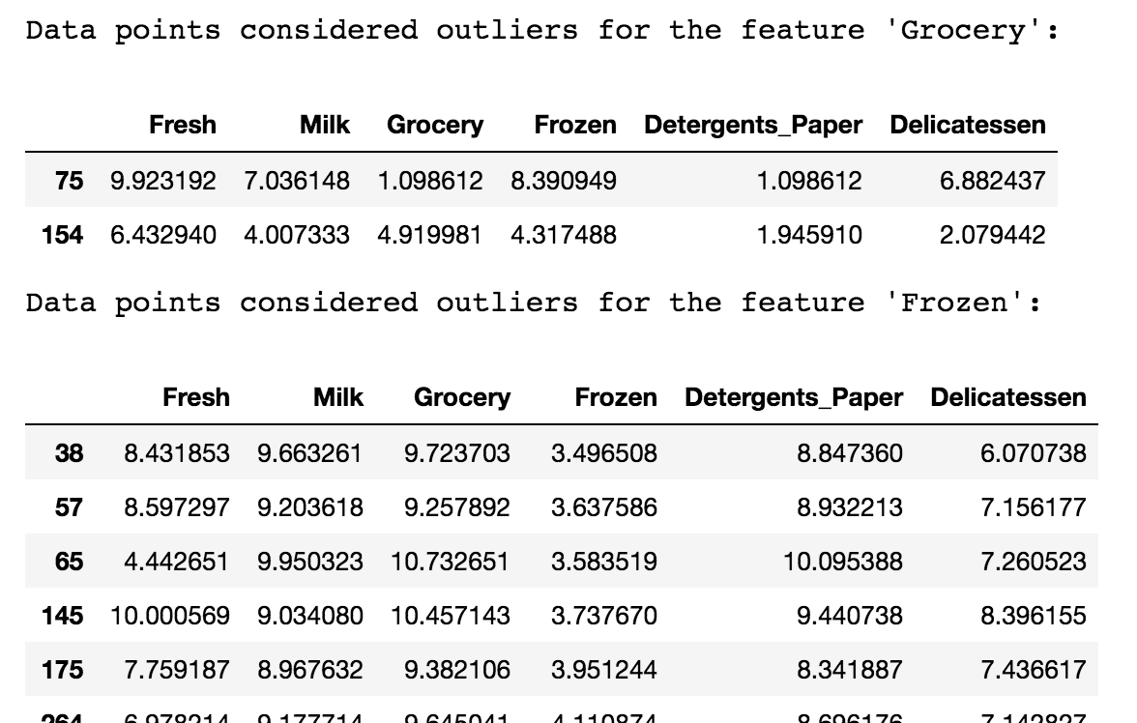

Slide 59
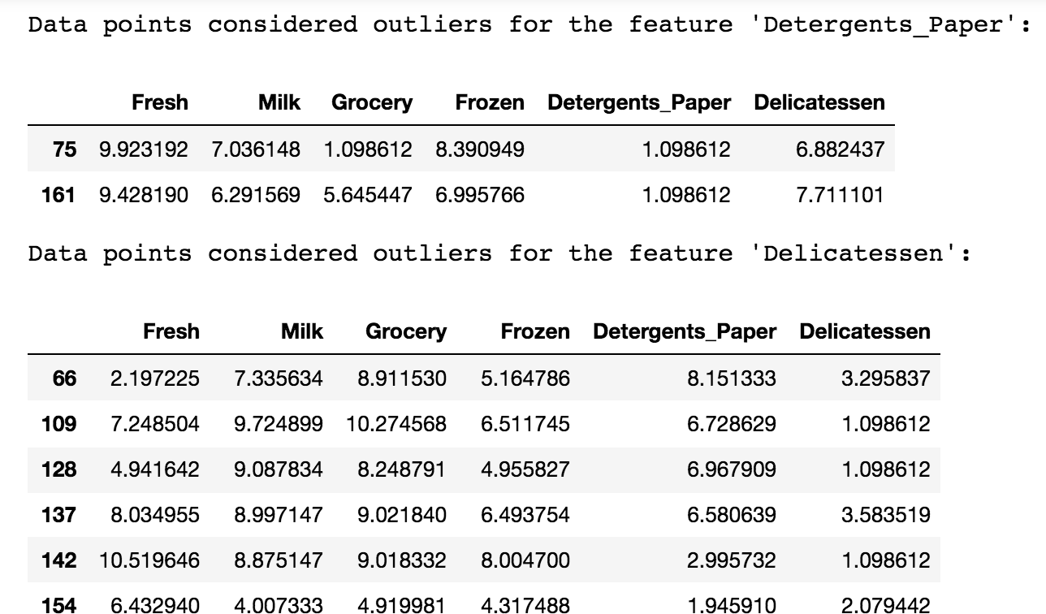

Slide 60
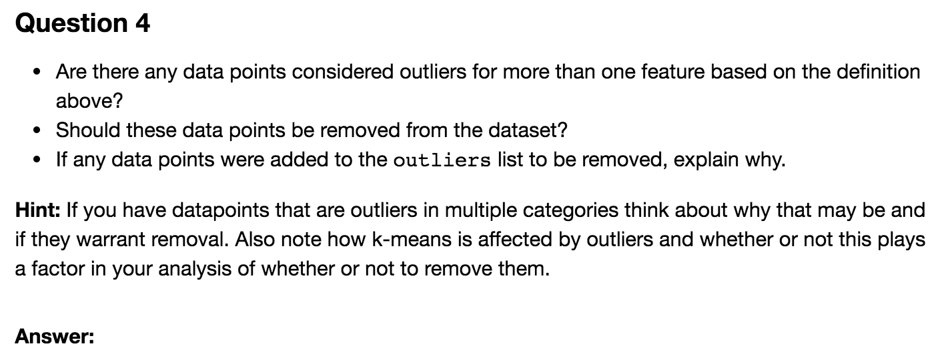

Slide 61
Feature Transformation

Slide 62
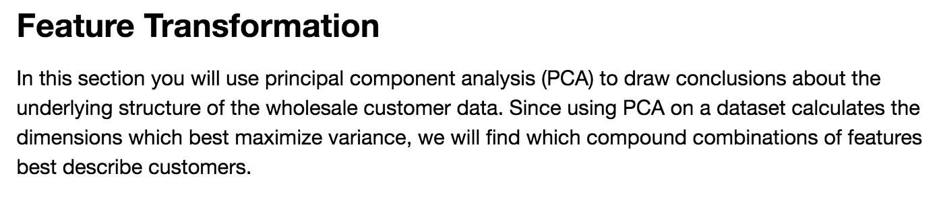

Slide 63
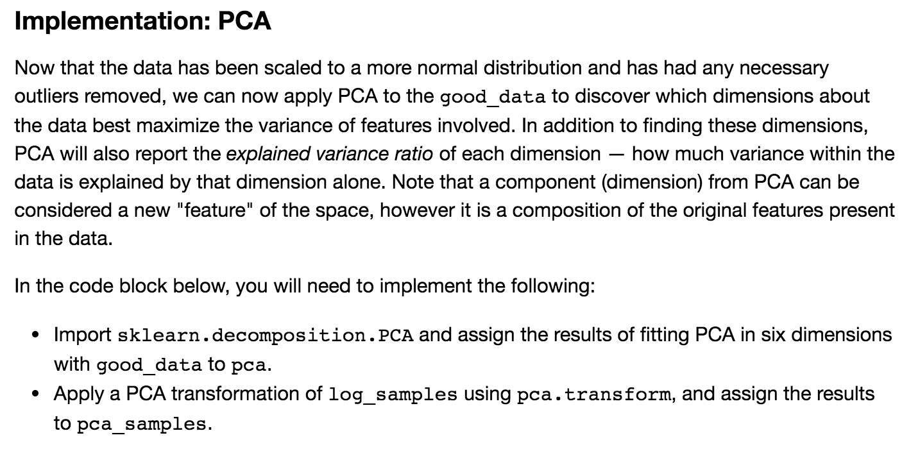

Slide 64
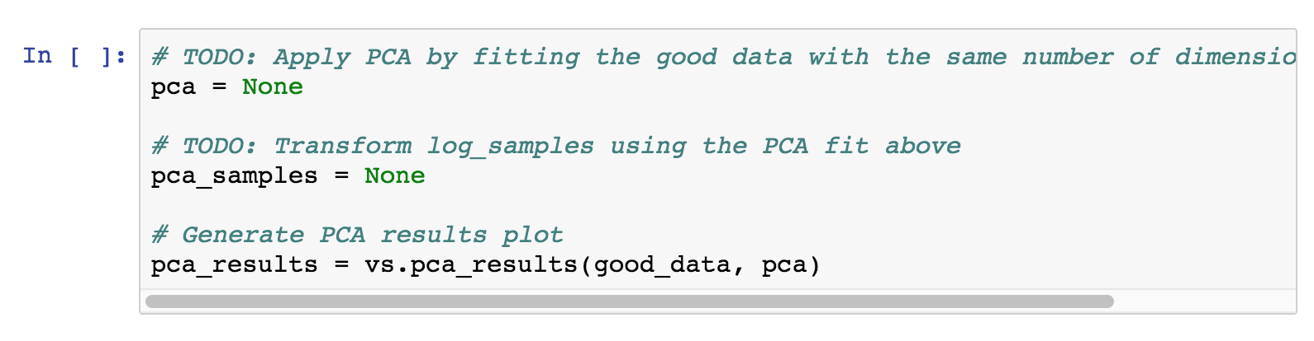

Slide 66
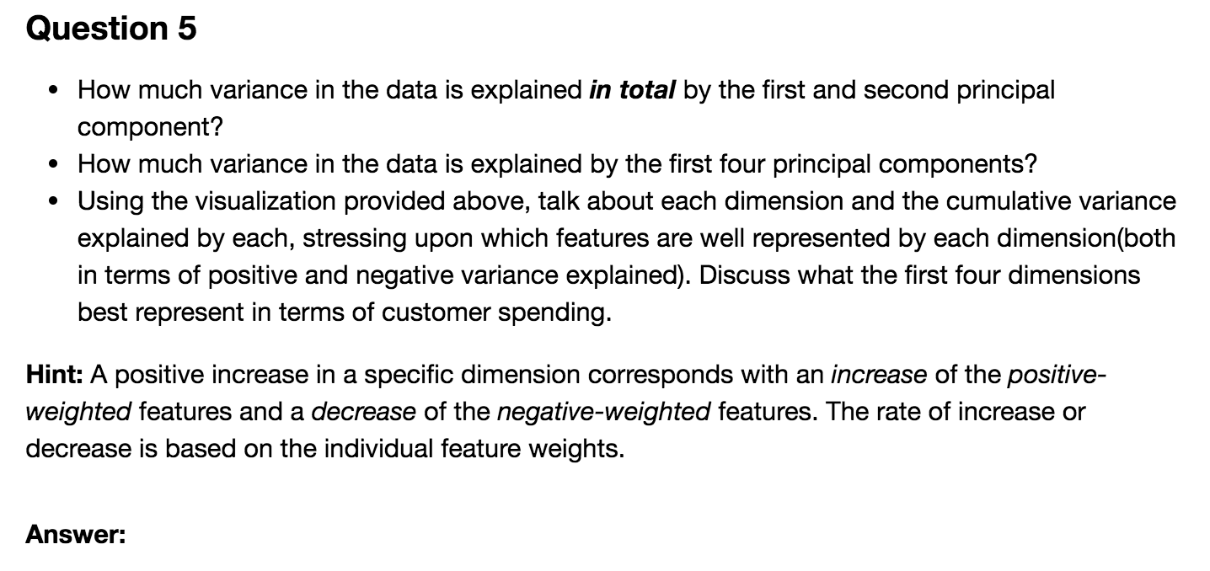

Slide 67
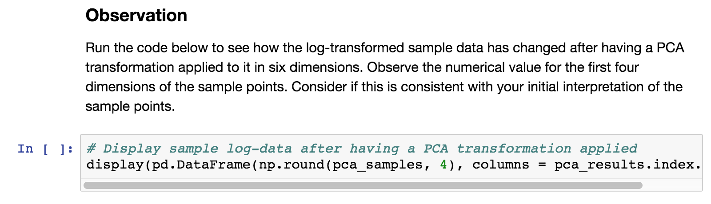

Slide 68
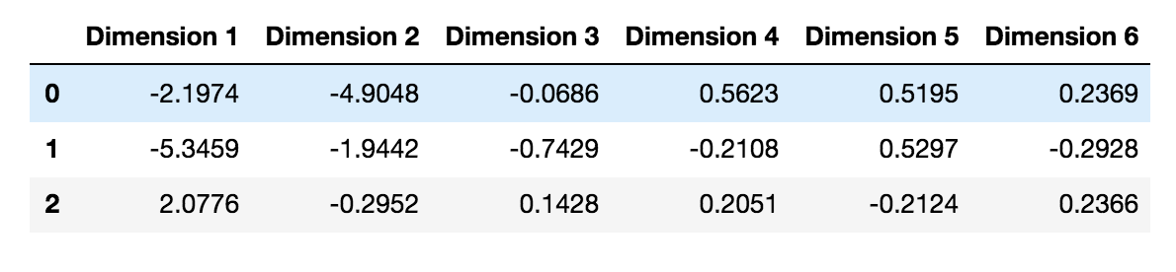

Slide 69
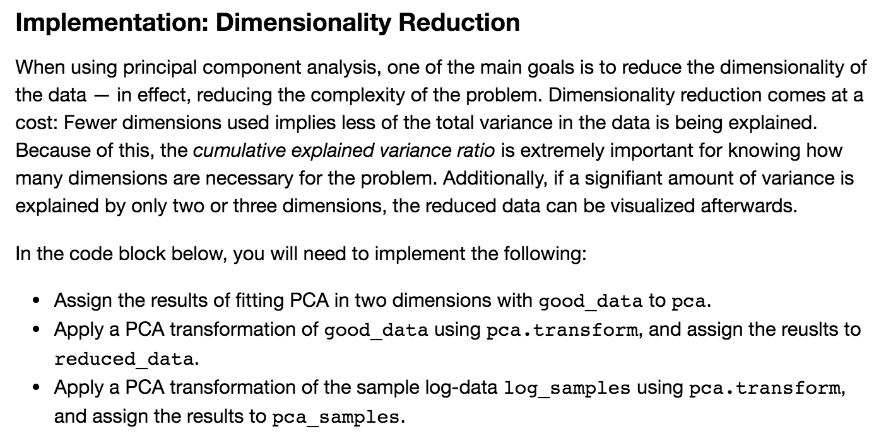

Slide 70
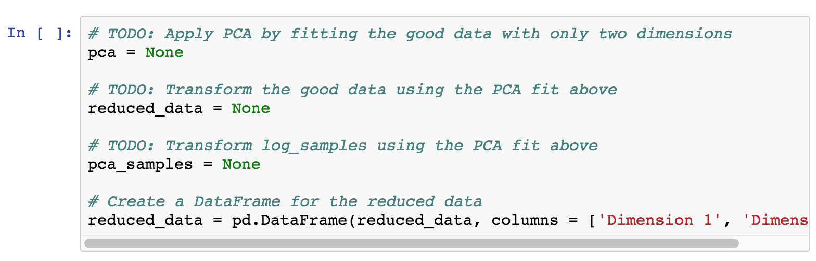

Slide 71
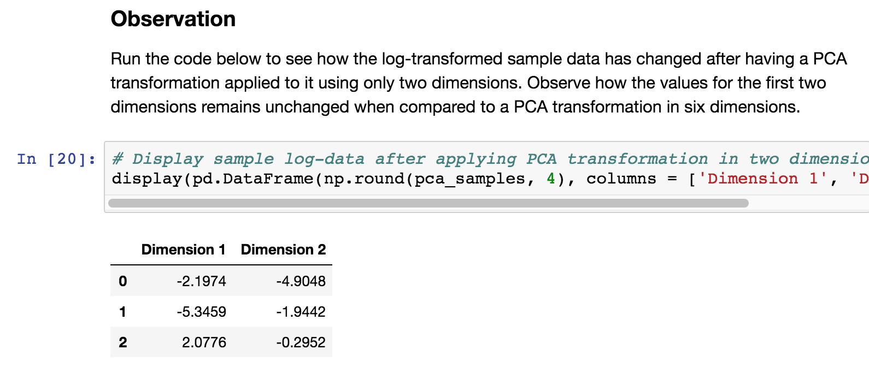

Slide 72
Clustering

Slide 73
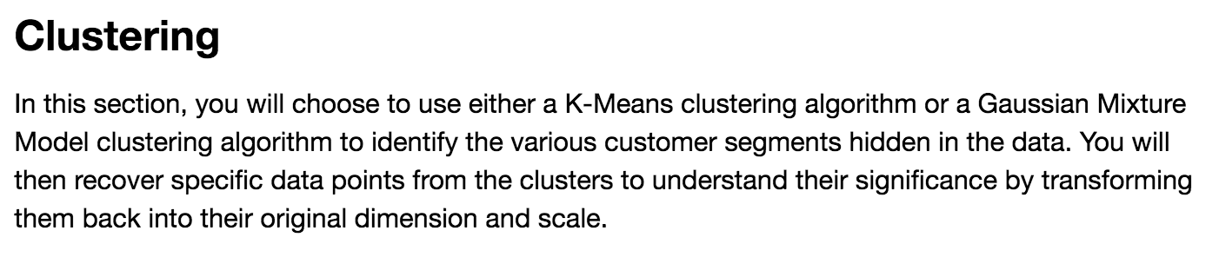

Slide 74
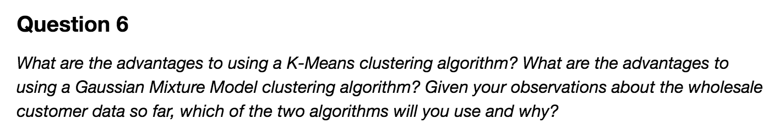

Slide 75
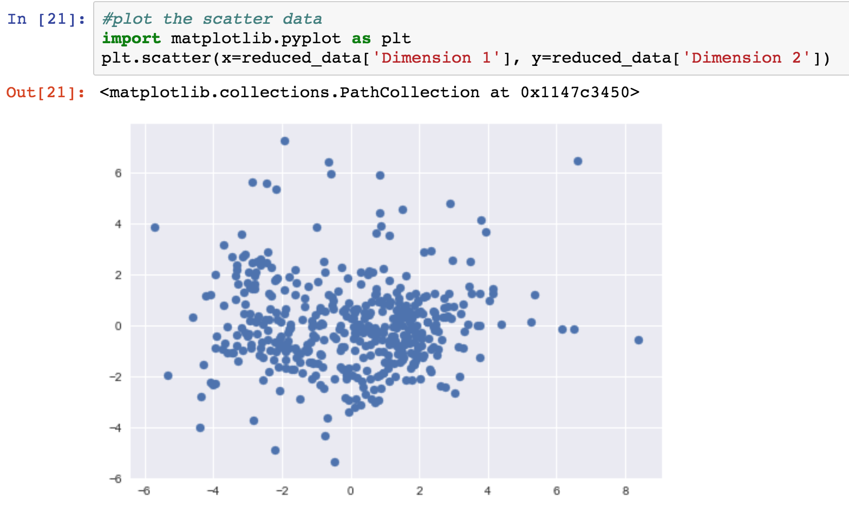

Slide 76
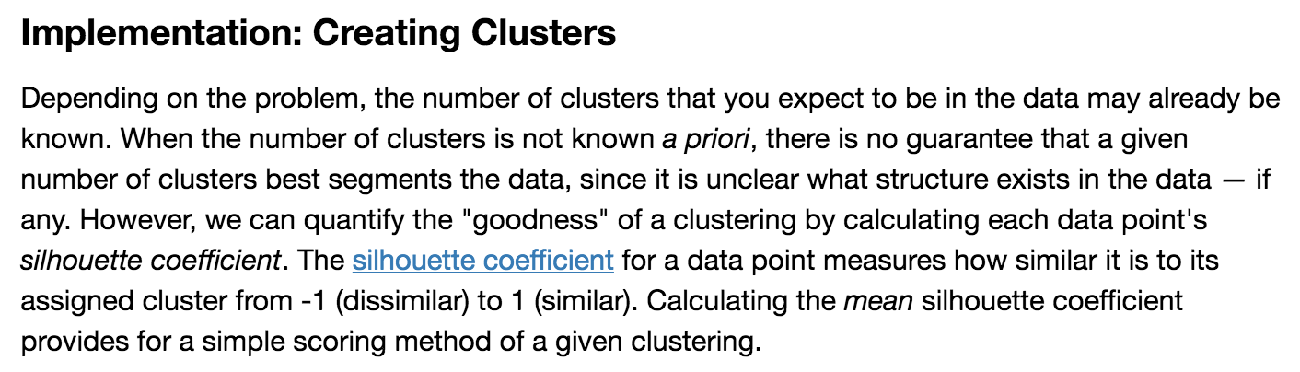

Slide 77


Slide 78



Slide 79


Slide 80


Slide 82


Slide 83



Slide 84


Slide 85


Slide 86


Slide 87


Slide 88
Conclusions

Slide 89


Slide 90


Slide 91


Slide 92


Slide 94


